Slide 1
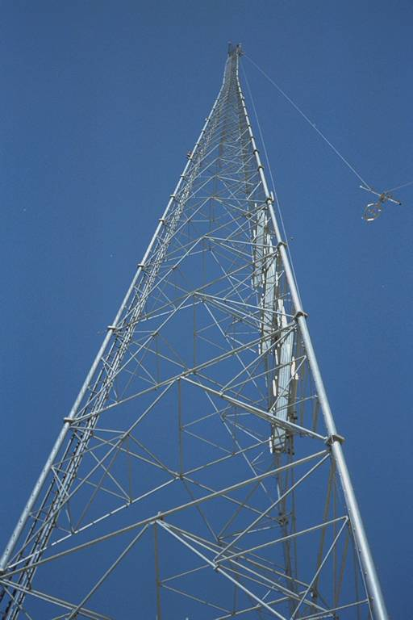
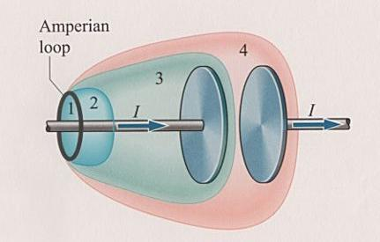
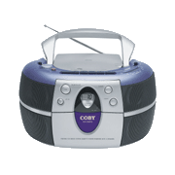
Chapter 38 Maxwell's
Equations
circuit

Slide 2
38-1 The basic equations of electromagnetisms
Introduction:
Classical Mechanics: the Newton’s Laws
Thermodynamics: the three thermodynamics Law
Electromagnetism, Optics: Maxwell’s Equations
the prediction of electromagnetic waves that travel with the speed of light.

Slide 3
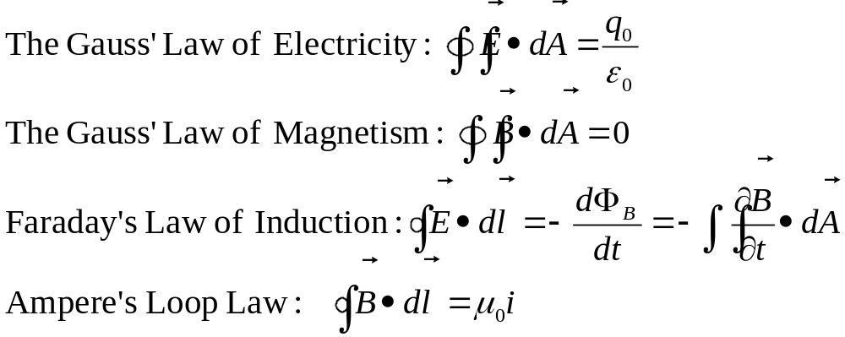
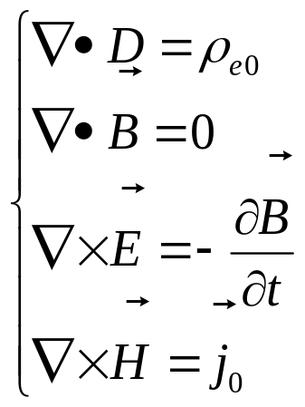
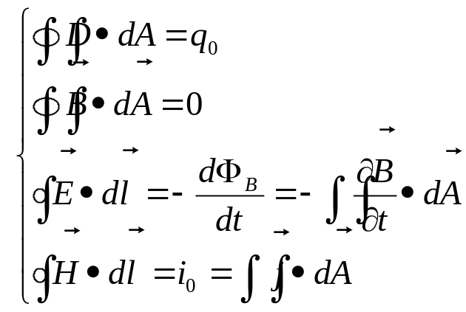
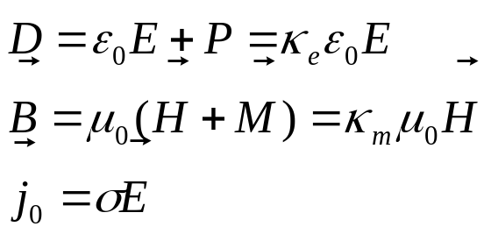
2. The tentative basic equations of electromagnetism
In vacuum:
In the dielectric and magnetic materials

Slide 4
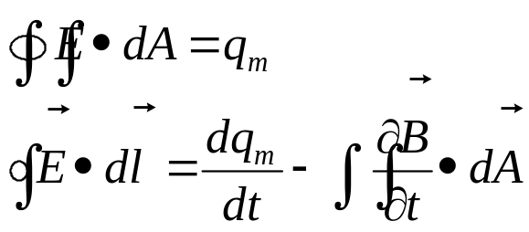
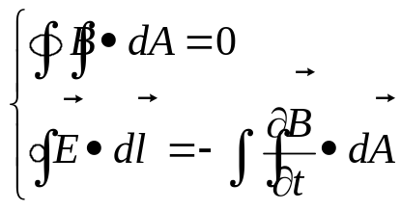

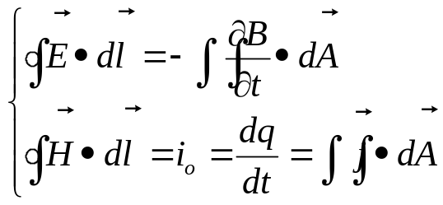

The principle of symmetry
(对称性原则)
How it permeates physics!
How it has often lead to new insight or discovery!
positive electrons, relativity, Maxwell’s Equations
Notes: (a) magnetic monopoles: q_{m}
(b)
Changing B , produce E
Changing E , Produce B ?
Displacement Current (位移电流）

Slide 5
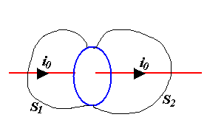
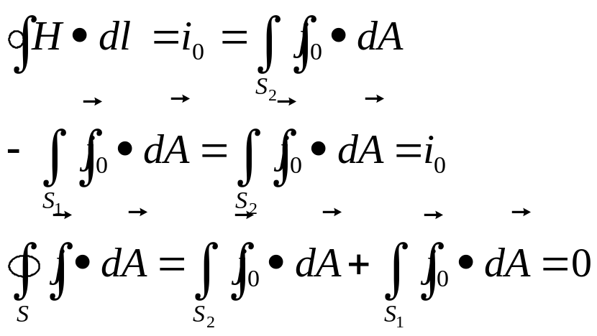
Ampere’s loop law
At steady condition, current is continuous.
Not at steady condition i₀(t)

Slide 6


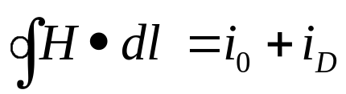
Maxwell’s Displacement Current
Consider applying Ampere’s Law to the current shown in the diagram.
  If the surface is chosen as 1, 2 or 4, the enclosed current = I
  If the surface is chosen as 3, the enclosed current = 0! (i.e., there is no current between the plates of the capacitor)
circuit
Big Idea: In order to have
for surface 1 = for surface 3
Maxwell proposed there was an extra “displacement current” in the region between the plates, equal to the current in the wire→
Modified Ampere’s law:

Slide 7
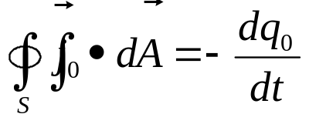
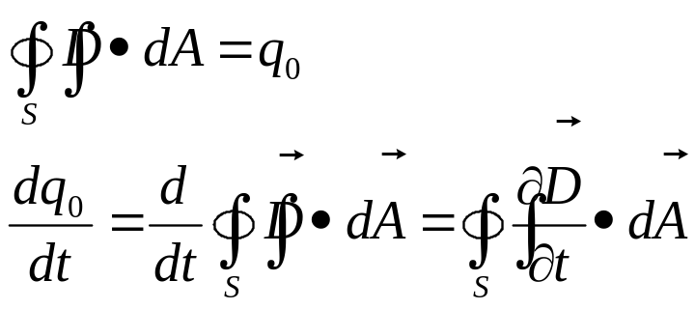
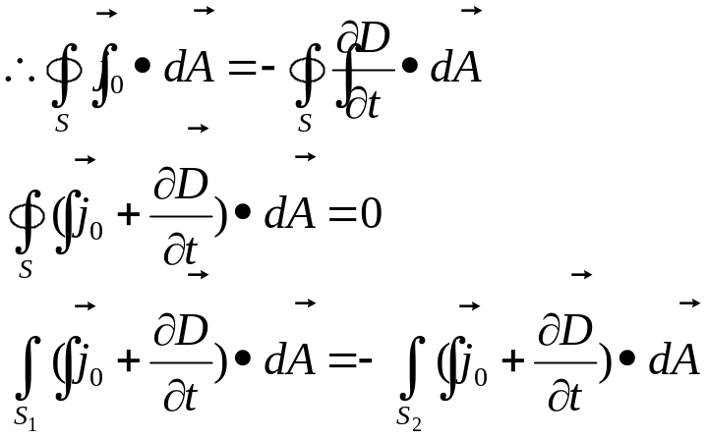
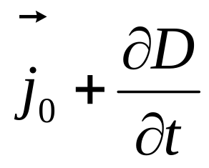
38-2 Induced Magnetic Field and the Displacement current
Not at steady condition
circuit
From Gauss’ Law:
Is continuous.

Slide 8
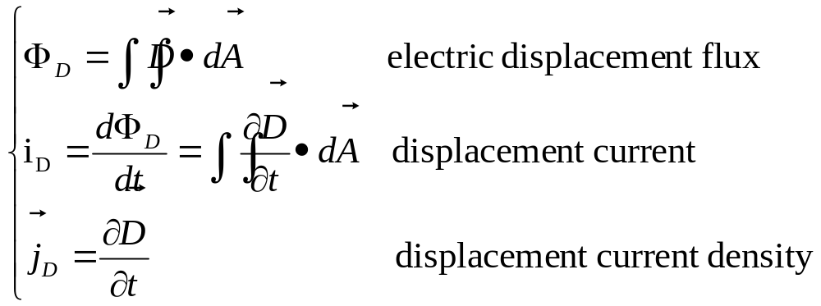
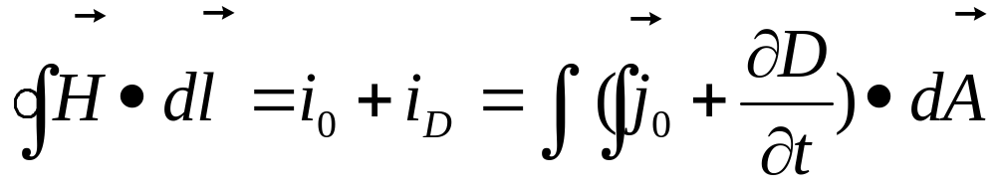
Maxwell’s Displacement Current
电位移通量
位移电流
位移电流密度
New Ampere’s Loop Law:

Slide 9
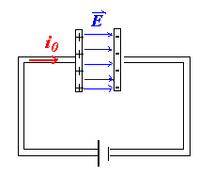
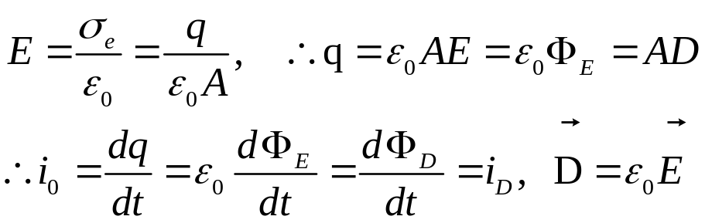
Notes
Both ways of producing a magnetic field:
by a conducting current (q motion)
by a changing electric displacement flux Φ_{D}
The displacement current in the gap equals to the conduction current in the wires, which shows the current is continuous.
Consider in vacuum:
In the wires, there is only conduction current i₀.
In the gap, there is only displacement current i_{D}.
When the capacitor is fully charged, then i₀=0, i_{D}=0

Slide 10
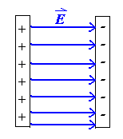
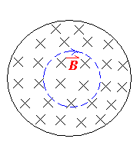
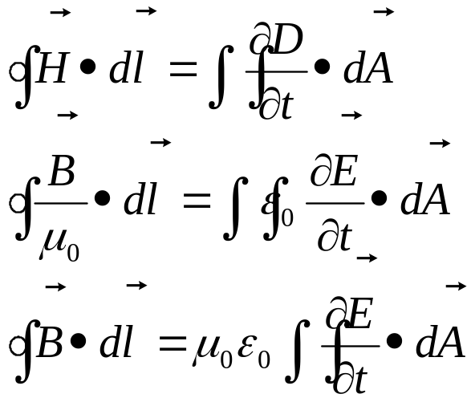
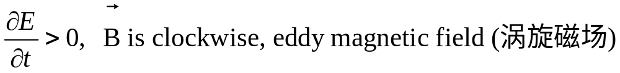
Notes (con.)
The induced magnetic field B is produced by the changing electric filed E inside the capacitor.

Slide 11
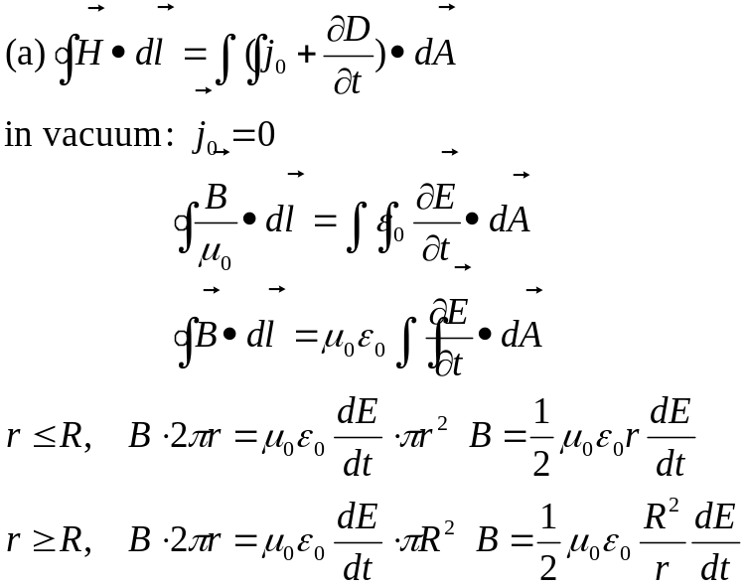
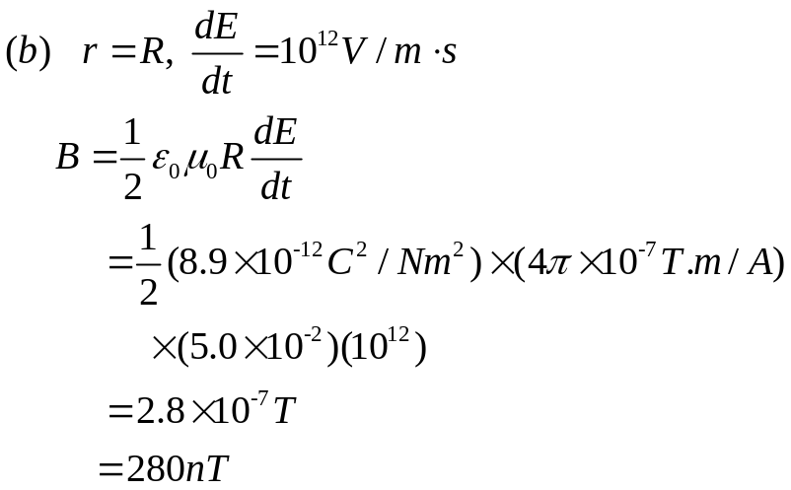
Example Page863, problem 38-1
A Parallel-plate capacitor
Derive an expression for the induced magnetic field at radius r in the region between the plates. Consider both r≤R and r≥R.
Find B at r=R for dE/dt=10¹²V/m•s and R=5.0 cm.
Solution:
They can scarcely be measured with simple apparatus.

Slide 12
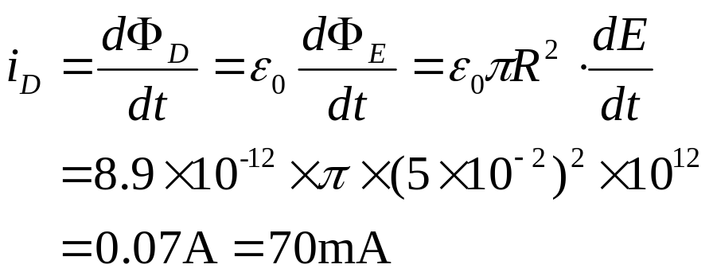
Example Page864, problem 38-2
What is the displacement current for the situation of Sample Problem 38-1?
Solution:
i_{D} is a reasonably large current, but B=280nT, Why?
Under the same conditions, both kinds of current are equally effective in generating magnetic field.

Slide 13
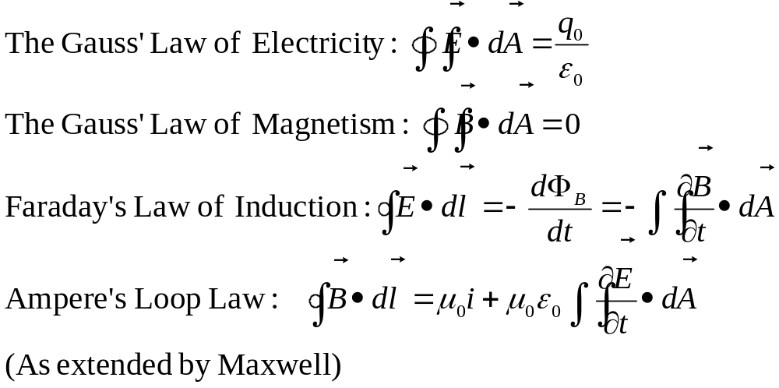
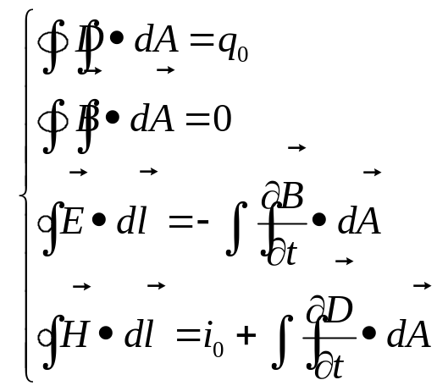
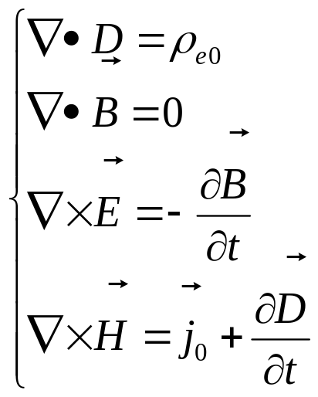
38-3 Maxwell’s Equations
In vacuum:
In the dielectric and magnetic materials

Slide 14
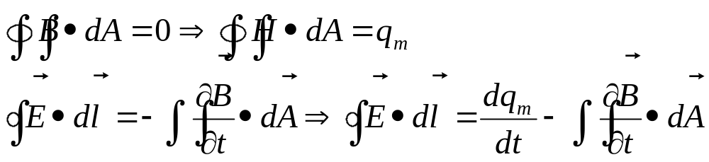

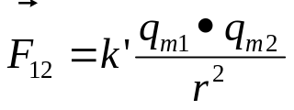
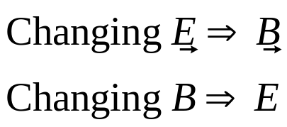
Notes for Maxwell’s Equations
Symmetry: There are still not completely symmetric.
If the existence of individual magnetic charges (monopoles) were confirmed, a completely symmetric set would result.
Electromagnetic waves.
Before Maxwell’s time (1873), no new predictions arise from from 4 equations. 1888, EW was discovered by Hertz.
Electromagnetic waves.
Electromagnetism and relativity:
Newton’s Law 17th c
Maxwell Eqs. 19th
Relativity, 1905 Einstein

Slide 15
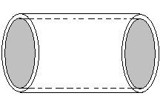
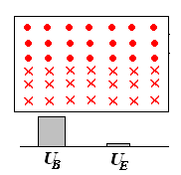
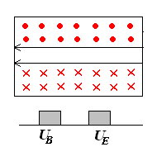
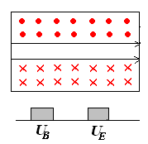
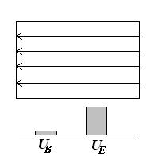
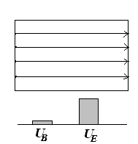


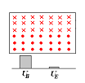
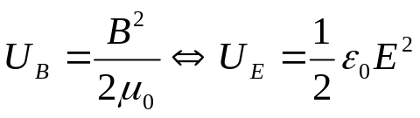
Maxwell’s Equations and Cavity Oscillations
(谐振腔)
Oscillation

Slide 16
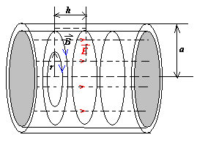
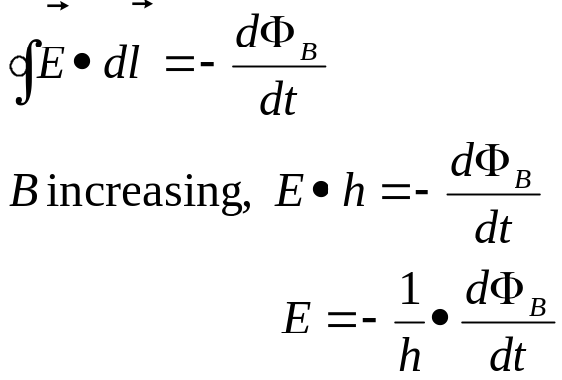
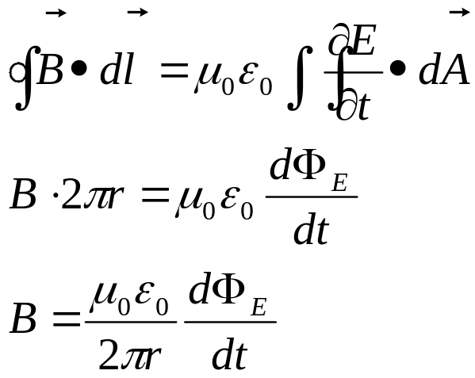
Cavity Oscillations (Con.)
From Faraday’s Law
From Ampere’s Loop Law
A more detailed representation of a cylindrical electromagnetic resonant cavity

Slide 17
Homework
Page 876 Exercises 5, 7,
Page 879 Problems 1, 3, 4

